Slide 1


Hotel Reservation Analysis
Thuraya Ayman

Slide 2
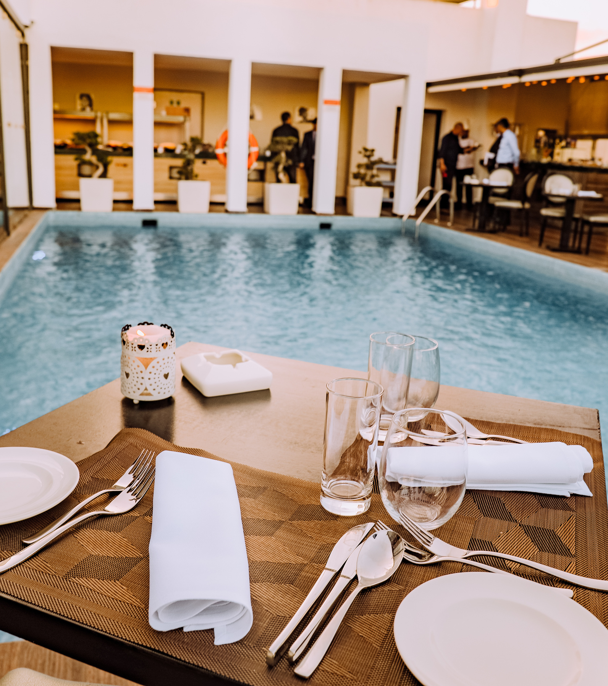



Introduction
Notes:
a presentation on analyzing hotel reservation data.
we will explore key insights and trends derived from a dataset of hotel reservations.
Using SQL queries, we will answer various questions about the reservations, such as the most popular meal plans, the common room types, and the market segment generating the highest average price per room.
Our goal is to understand the patterns and preferences of hotel guests, which can help in making data-driven decisions for better management and improved guest satisfaction.

Slide 3

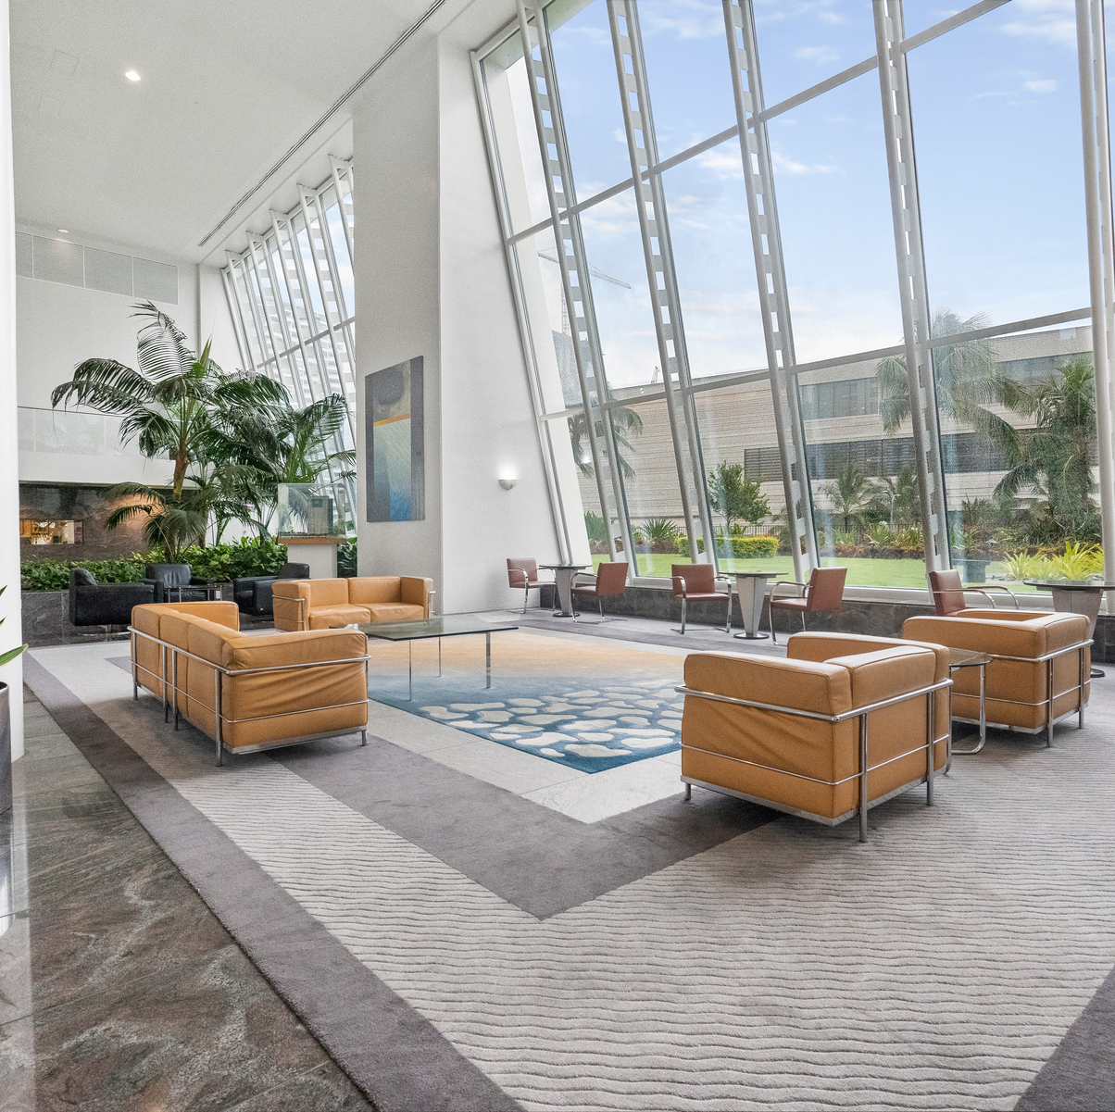

Total number of reservations in the analysis was 700

Slide 4
Most Popular meal
Average price per room for reservations involving children
Reservations by year
Meal Plan 1
144.568
in 2017 it was 123
in 2018 it was 577
Notes:
Now let's view the numbers and insights we found out :

Slide 5
Commonly booked room types
Reservations falling on weekends
Lead time for reservations
Highest lead time was 443
Lowest lead time was was 0
Room_Type 1
383
Notes:
Now let's view the numbers and insights we found out :

Slide 6
Average Number of Weekend nights for reservations with children
most common market segment type for reservations
Total number of adults and children
Online
Adults 1316
Children 69
1
Notes:
Now let's view the numbers and insights we found out :

Slide 7
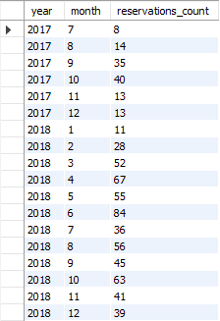
Monthly reservations by year
Unforgettable escape
Curated experiences
Notes:
These are the monthly reservations by year

Slide 8
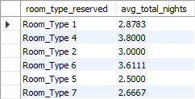
Average nights spent by room type
Unforgettable escape
Curated experiences
Notes:
And average nights spent by room type

Slide 9
Thank you!

